Slide 1


Test construction and preparation of students for licensure and certification examination
Under Supervised by
Prof. Dr. Effat Elkarmalawy
Prof. Dr. Enas Helmy
Prof. Dr. Heba Ahmed
Presented by
Faten Ziad Madi
Amal sobhy

Slide 2
Objectives:
At the end of the session, the participants should be able to:
Discuss of test construction
Assess the characteristic of test construction
Differentiate types of NCLEX examination plan.

Slide 3
Outlines:
Definition of test construction
Purpose of test construction
Steps of test construction
Rules of test construction
Example of Objective test
Key benefits of using artificial intelligence
NCLEX-RN – NCLEX-PN EXAMINATION TEST PLAN

Slide 4
Introduction
Technological advancements have also transformed test construction practices. The adoption of machine learning techniques in computerized adaptive testing (CAT) allows for the dynamic adjustment of test questions based on an examinee's performance, leading to more efficient and personalized assessments. This approach not only reduces test length but also maintains high levels of accuracy and security. (Wanyong, F.2023)

Slide 5
Introduction
Test construction is a systematic process of developing assessments that accurately measure specific knowledge, skills, or abilities. This process involves several key steps: defining the construct to be measured, designing test items, analyzing item quality, and validating the overall test to ensure reliability and fairness.(Sallehuddin ,Md Yusof.2023)

Slide 6
Definition test construction
Test construction is the systematic process of developing assessments designed to measure specific psychological functions, encompassing activities from initial design to final evaluation. (Zeichner et al., 2024)

Slide 7
Purpose of
To assess how well students are achieving the stated goals of the lesson.
To provide the instructor with an opportunity to reinforce the stated objectives and
Test construction
Highlight what is important for students to remember

Slide 8
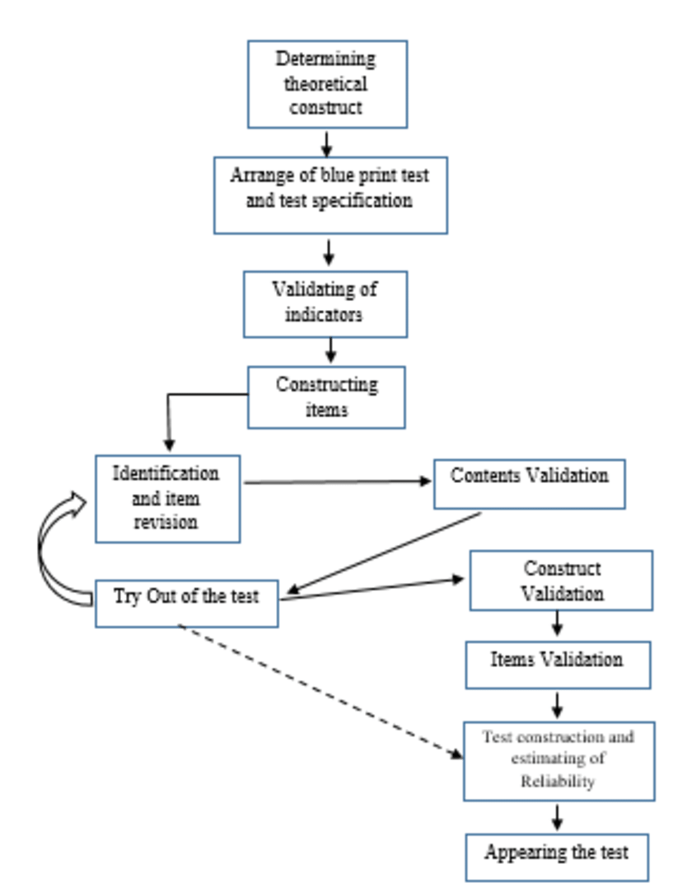
L N R Marfu’i et al 2019

Slide 9
Steps of test construction
The purpose of a test is to evaluate specific knowledge, skills, or abilities in alignment with the learning objectives of a course or program. Clearly defining this purpose ensures that the test effectively measures what it is intended to assess, guiding both test construction and interpretation of results. According to Zeichner et al. (2024), this step is crucial in ensuring validity and reliability in assessment design.

Slide 10
Cont. purpose of test construction
For example, the purpose of a medical licensing exam is to assess whether candidates have the necessary clinical knowledge, diagnostic reasoning, and patient care skills to practice medicine safely and effectively. This test ensures that all licensed professionals meet a standardized level of competency, protecting public health and maintaining the integrity of the healthcare system

Slide 11
Steps of test construction
2. Determine the content and format of the test: This involves selecting appropriate item formats, such as multiple-choice, true/false, or essay questions, and deciding on the number and type of items to include on the test. Example: a nursing certification exam may include questions on patient assessment, medication administration, and emergency response protocols. The test format consists of multiple-choice questions to assess theoretical knowledge, true/false questions to evaluate understanding of best practices, and case scenario questions to measure critical thinking and decision-making skills in clinical situations. (Zeichner et al., 2024)

Slide 12
Steps of test construction
3. Writing test items involves creating questions or tasks that accurately measure the intended knowledge, skills, or abilities. Test items should be clear, unambiguous, and aligned with the test’s purpose. There are different types of test items, including multiple-choice questions, true/false statements, short-answer questions, and performance-based tasks. Each type should be chosen based on the nature of what is being assessed. (Zeichner et al., 2024)

Slide 13
Steps of test construction ,cont.
3. Write test items:
Creating effective test items is crucial for accurate assessment. Explore the purpose, types, and guidelines for crafting impactful test items.
Purpose of Test Items:
Test items serve multiple purposes in assessments. They measure knowledge, skills, and abilities, provide feedback, and guide instruction.

Slide 14
Writing Test Items ,cont
General Rules for Writing Test Items:
1. Every item should measure something important, have a correct answer, use simple, clear, concise, precise, grammatically correct language, avoid using jargon, slang, or unnecessary abbreviations.
2. Try to use positive wording.
3. No item should contain irrelevant clues to the correct answer.

Slide 15
Writing Test Items ,cont
General Rules for Writing Test Items:
4. No item should depend on another item for meaning or for the correct answer.
5. Eliminate extraneous information unless the purpose of the item is to determine whether students can distinguish between relevant and irrelevant data.
6. Arrange for a critique of the items.
7. Prepare more items than the test blueprint specifies.

Slide 16
Steps of test construction, cont.
4. Determine the scoring procedure: The scoring procedure for the test should be determined in advance. This involves deciding on the number of points assigned to each item, as well as any partial credit. (Zeichner et al., 2024)
Example: Multiple-choice questions are scored with one point for each correct answer, while case scenario questions are scored based on the accuracy of the response and the number of correct steps.

Slide 17
Steps of test construction
5. Pilot test the items: Before administering the test to students, it is important to pilot test the items to ensure that they are valid and reliable. This involves administering the test items to a small group of students and analyzing the results to identify any problems or issues with the items. (Zeichner et al., 2024)
Example: Administer the test to a group of 10-20 trainee nurses to analyze the clarity and appropriateness of the questions.

Slide 18
Steps of test construction, cont.
6. Administer the test: Once the test items have been pilot tested and revised as necessary, the test can be administered to students. It is important to ensure that the test is administered under standardized conditions to ensure that the results are valid and reliable. (Zeichner et al., 2024)
Example: Conduct the test with 100 nurses at an accredited hospital.

Slide 19
Steps of test construction
7. Analyze the results: After the test has been administered, the results should be analyzed to determine the effectiveness of the test in measuring the intended learning outcomes. This involves calculating the reliability and validity of the test scores, as well as analyzing the performance of individual students and groups of students. (Zeichner et al., 2024)

Slide 20
Steps of test construction
7. Analyze the results:
Example: Analyze the scores to determine the difficulty level of the questions and identify topics that need modification or improvement, while evaluating the test’s reliability.

Slide 21
Rules of test construction
❑ Validity: They accurately measure the skills or knowledge they are intended to assess. In other words, a test must measure what it's supposed to measure.
❑ Reliability: They produce consistent results over time. In other words, if the same test is administered to the same group of people multiple times, the results should be consistent.

Slide 22
Cont. Rules of test construction
❑ Objectivity: They are free from bias and that the same results would be obtained regardless of who administers the test.
❑ Clarity: Tests must be clear and easy to understand. Test items should be written in clear, concise language that is appropriate for the intended audience.

Slide 23
Cont. Rules of test construction
Relevance: They are appropriate for the intended audience and measure skills or knowledge that are important and useful.
❑ Fairness: All test-takers are given an equal opportunity to succeed on the test. This includes ensuring that the test is culturally sensitive and free from any form of discrimination.
❑ Security: They are protected from cheating.

Slide 24

Artificial Intelligence in Test Construction and Student Preparation for Licensure and Certification Examinations

Slide 25
Artificial Intelligence in Test Construction and Student Preparation for Licensure and Certification Examinations
Introduction:
Artificial Intelligence (AI) is transforming the field of education and assessment, particularly in the construction of tests and the preparation of students for high-stakes licensure and certification examinations. AI-driven tools help in automating test generation, ensuring fairness in assessment, providing personalized learning experiences, and enhancing test security. (Martin, F., & Polly, D. 2019).

Slide 26
The role of artificial technology in test construction.
Artificial Intelligence (AI) plays a significant role in test construction, transforming how assessments are designed, delivered, and analyzed.
1. Automated Item Generation (AIG)
AI can generate test questions based on predefined criteria, such as difficulty level, cognitive skills, and subject matter.
Natural Language Processing (NLP) enables AI to create multiple-choice, true/false, and open-ended questions from learning materials
(Wilson & Kelley, 2022)

Slide 27
The role of artificial technology in test construction cont..
2. Adaptive Testing
AI-driven adaptive testing adjusts the difficulty of questions in real time based on a test-taker’s responses.
This ensures a more accurate assessment of the learner's ability while reducing test anxiety.
3. Intelligent Feedback and Scoring
AI can instantly grade multiple-choice and essay-based responses using NLP and machine learning models.
Provides detailed feedback to learners, highlighting areas for improvement

Slide 28
The role of artificial technology in test construction cont..
4. Plagiarism Detection & Authenticity Verification
AI tools like Turnitin and Grammarly check for plagiarism in open-ended responses.
AI-powered proctoring ensures test integrity by monitoring behavior during online assessments.
5. Customization & Personalization
AI tailors tests to individual learning styles and needs, creating personalized learning experiences.
Helps instructors create exams that align with specific curriculum goals.

Slide 29
The role of artificial technology in test construction cont..
6. Data-Driven Insights & Predictive Analytics
AI analyzes student performance trends to predict outcomes and improve future test designs.
Identifies question difficulty levels and assesses test fairness.
7. Test Security & Fraud Detection
AI detects unusual test-taking patterns to prevent cheating.
Uses facial recognition and keystroke dynamics for identity verification.

Slide 30
AI in Test Construction
AI plays a critical role in the design and development of exams that assess competency and knowledge across various disciplines, including nursing, medicine, law, and engineering. (Gierl, M. J., Lai, H., & Hogan, J. 2020)
2.1. Automated Item Generation (AIG)
AI-powered algorithms generate multiple-choice, short-answer, and essay-based questions based on predefined parameters, such as:
Bloom’s Taxonomy levels (e.g., knowledge, application, analysis).
Cognitive complexity (low to high-order thinking skills).
Content relevance and validity (ensuring alignment with learning objectives).

Slide 31
AI in Test Construction , cont..
2.2. Adaptive Testing
AI enables Computerized Adaptive Testing (CAT), where test difficulty adjusts in real-time based on a student’s performance.
This:
Reduces test anxiety.
Provides a more accurate measure of competency.
Shortens test length while maintaining reliability.

Slide 32
AI in Test Construction , cont..
2.3. AI-Based Test Security and Integrity
AI enhances exam security by:
Using facial recognition and keystroke dynamics to verify student identity.
Employing AI-powered proctoring to monitor test-takers through webcam and microphone analysis.
Detecting plagiarism and cheating attempts using NLP-based detection tools.

Slide 33
AI in Student Preparation for Licensure and Certification Exams
AI-powered platforms significantly improve student preparation for high-stakes exams such as the NCLEX (for nurses), USMLE (for medical doctors), and Bar Exam (for lawyers). (Luckin, R. 2018).
1. Personalized Learning and Tutoring Systems
AI adapts learning materials to individual student needs by:
Identifying strengths and weaknesses through performance analytics.
Providing targeted practice questions based on weak areas.
Offering interactive tutoring through AI-driven chatbots and virtual mentors.

Slide 34
AI in Student Preparation for Licensure and Certification Exams, cont..
2. AI-Powered Simulation and Case-Based Learning
AI-based virtual simulations provide students with real-world scenarios to enhance critical thinking and clinical decision-making. For example:
Nursing students use AI-based clinical simulations to practice diagnosing and treating patients.
Medical students engage in AI-driven case-based learning to improve diagnostic skills.

Slide 35
AI in Student Preparation for Licensure and Certification Exams, cont..
3. AI in Practice Tests and Predictive Analytics
AI-driven exam platforms analyze student performance and predict their likelihood of passing a licensure exam. Features include:
AI-powered practice exams with real-time feedback.
Predictive analytics identifying the probability of success based on past performance.
Automated remediation plans recommending study strategies and learning materials.

Slide 36
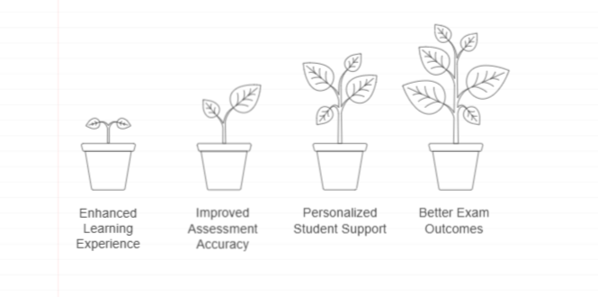
Key Benefits of Using Artificial Intelligence in Test Construction and Student Preparation
(Wilson & Kelley, 2022)

Slide 37
Test Construction and Preparation for NCLEX-RN and NCLEX-PN Examination Test Plan
The NCLEX-RN (National Council Licensure Examination for Registered Nurses) and NCLEX-PN (National Council Licensure Examination for Practical Nurses) are pivotal assessments that determine the competency of nursing graduates.
The test plans for these examinations are meticulously designed to evaluate the knowledge, skills, and abilities essential for safe and effective nursing practice. This document serves as a guide for educators and students in understanding the test construction process and preparing effectively for these licensure examinations.
(Patrick & Kini, 2023)

Slide 38
References
Zeichner. K. M, Darling-Hammond. L, Berman .A. I, Dong .D, & Sykes. G. (2024). Evaluating and Improving Teacher Preparation Programs. 33(4), 89-103. https://doi.org/10.54300/956.678
Wilson, S., & Kelley, S. (2022). Landscape of teacher preparation programs and teacher candidates. Committee on Evaluating and Improving Teacher Preparation Programs, National Academy of Education, 29(1), 53-67.
Patrick, S. K., Darling-Hammond, L., & Kini, T. (2023). Educating teachers in California: What matters for teacher preparedness Learning Policy Institute. https://doi.org/11.33300/966.634

Slide 39
References
L N R Marfu’i et al 2019 J. Phys.: The analysis of critical thinking skills test in social-problems for physics education students with Rasch Model:Conf. Ser. 1280 052012
Luckin, R. (2018). "Machine Learning and Human Intelligence: The Future of Education for the 21st Century." UCL Press.
Gierl, M. J., Lai, H., & Hogan, J. (2020). "The Role of Artificial Intelligence in Automated Test Assembly and Item Generation." Educational Measurement: Issues and Practice, 39(1), 6-17.
Billings, D. M., & Halstead, J. A. (2020). Teaching in nursing: A guide for faculty (6th ed.). Elsevier.

